Slide 1
Collection Framework How To Make Collection Read Only In Java?
momedaram

Slide 2

How To Make Collection Read Only In Java?
Read only collection is a collection which can not be modified once created.
Read Only → we can’t Add , Remove , Update.
→ Java.util.Collections
List → Collections.unmodifiableList(obj);
Set → Collections.unmodifiableSet(obj);
Map → Collections.unmodifiableMap(obj);
NavigatableSet → Collections.unmodifiableNavigableSet(obj);
NavigableMap → Collections.unmodifiableNavigableMap(obj);
SortedSet → Collections.unmodifiableSortedSet(obj);
SortedMap → Collections.unmodifiableSortedMap(obj);
Collection → Collections.unmodifiableCollection(obj);
If we try to modify (Add, Remove, Update ) the unmodifiable Collection , will get UnsupportedOperationException
we can perform any modification operations on original collection and those modifications are reflected in the read only collection.

Slide 3
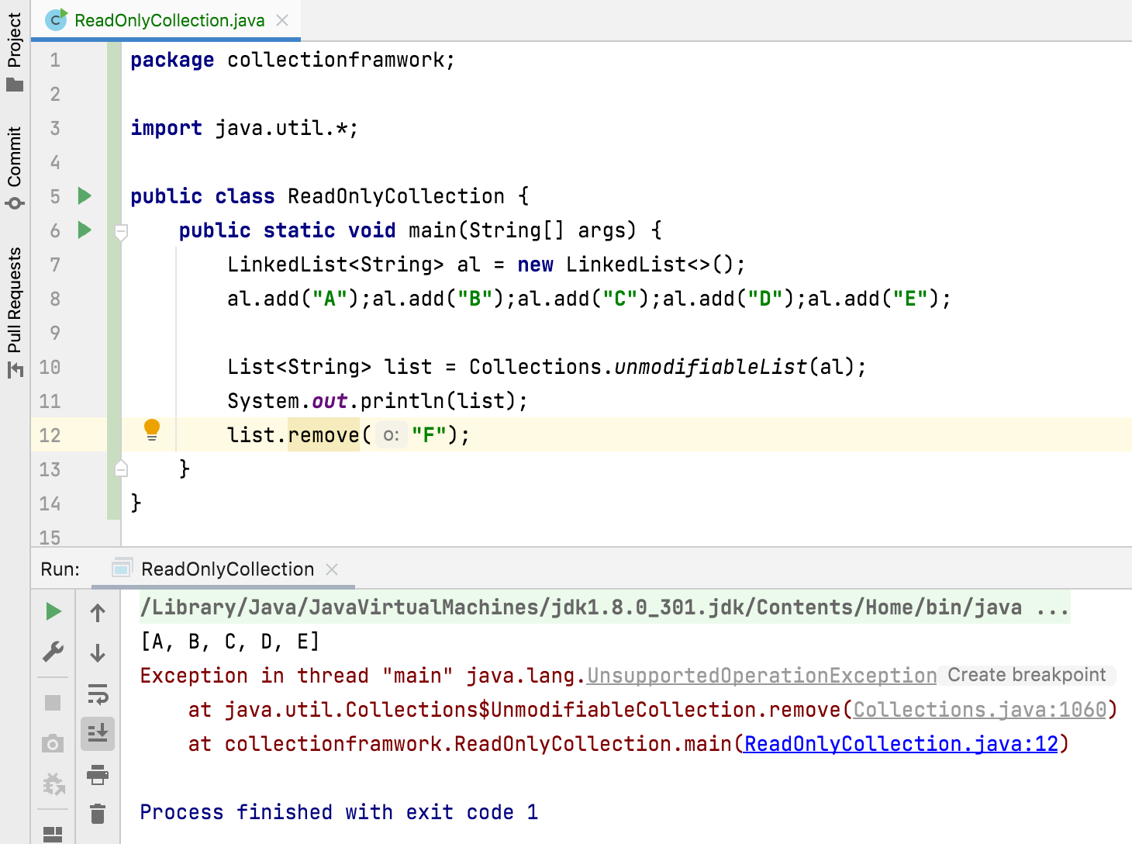
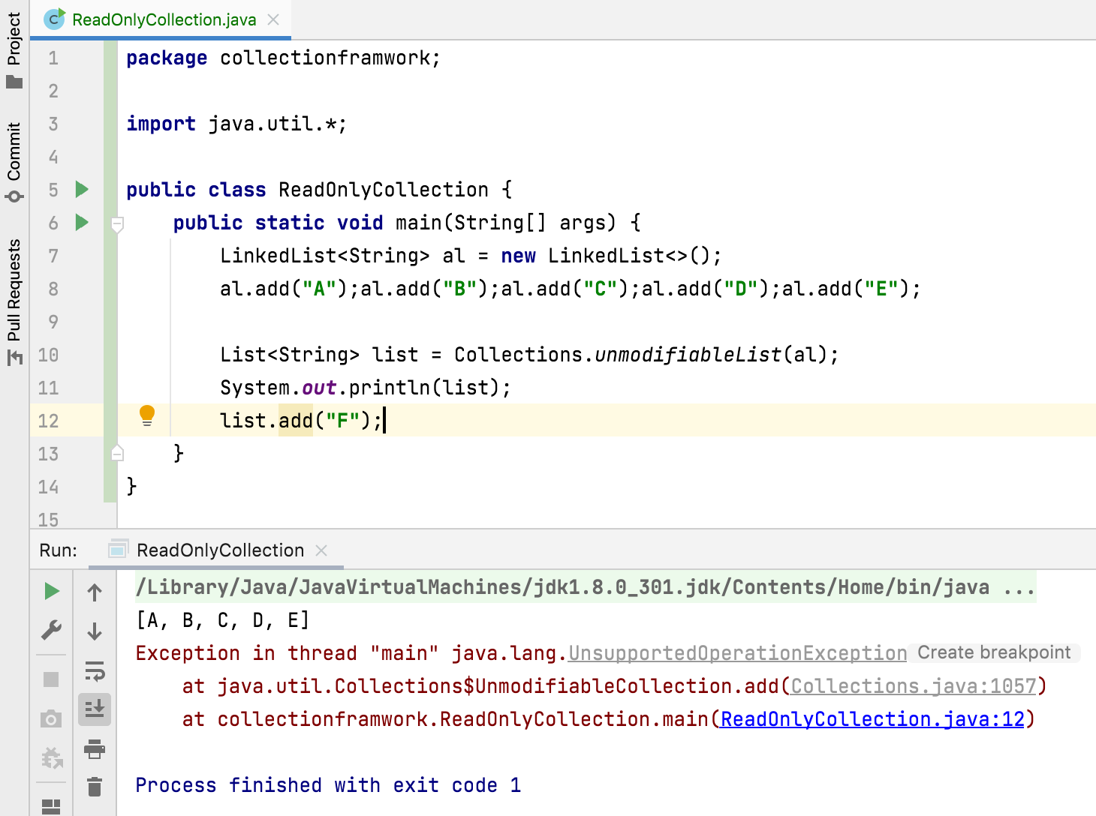

Slide 4
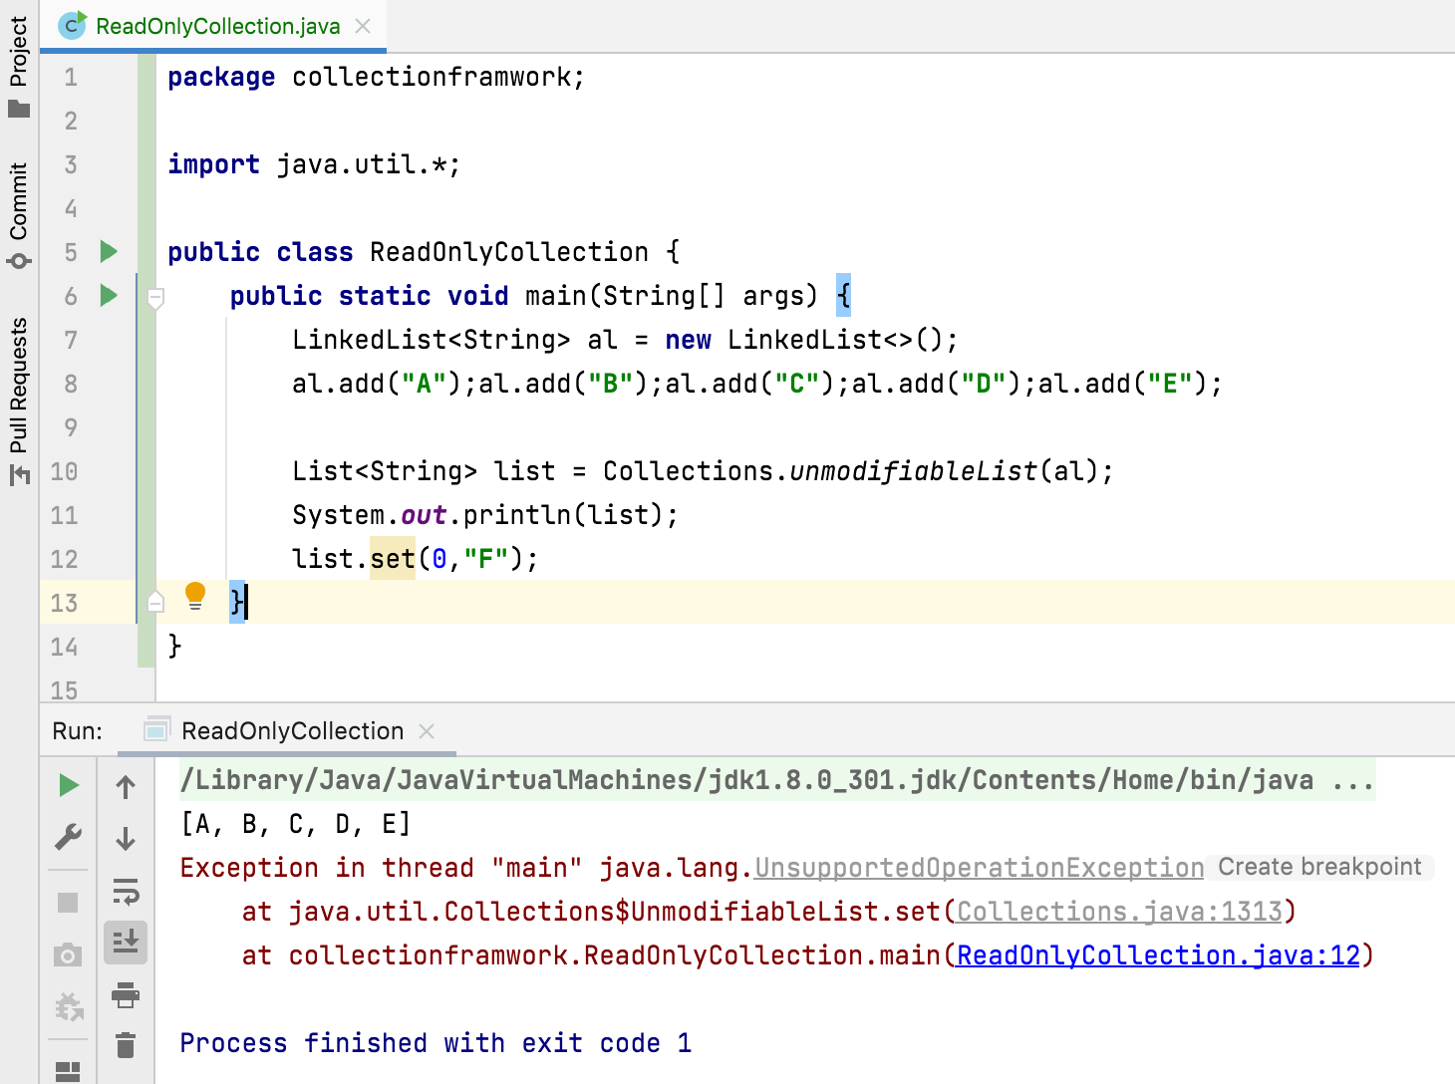
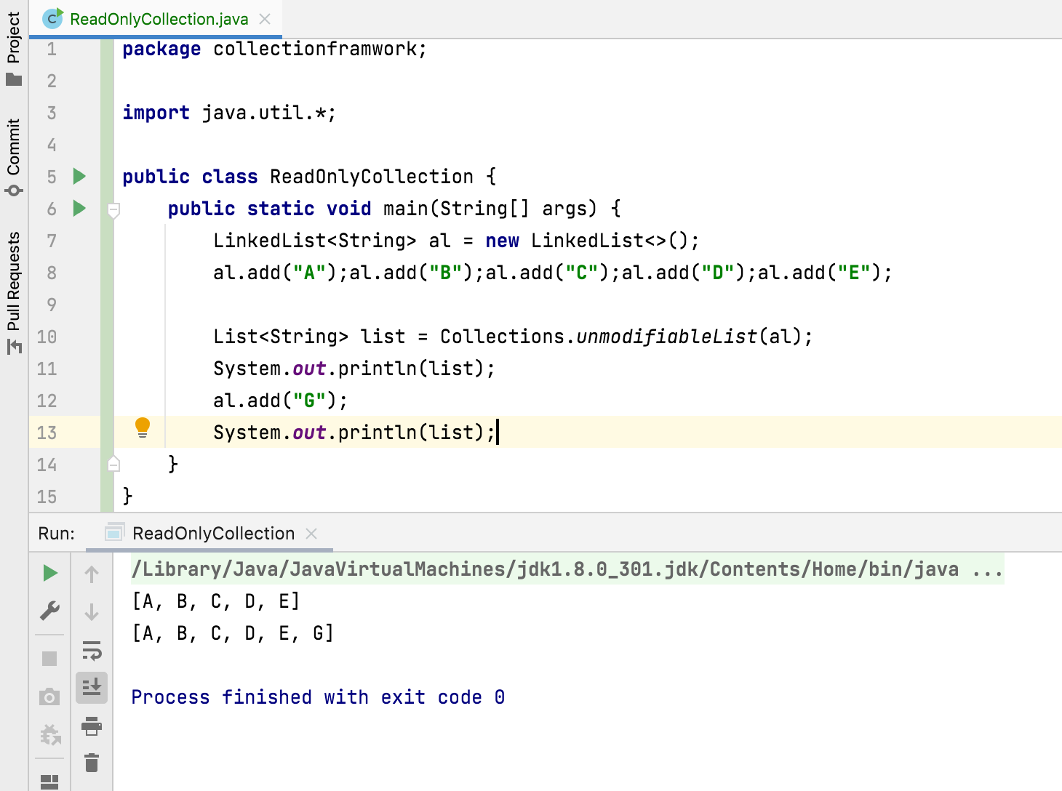

Slide 5
Thank You !
momedaram

